Slide 1

DEVOPS

Slide 2
Tools

Slide 3
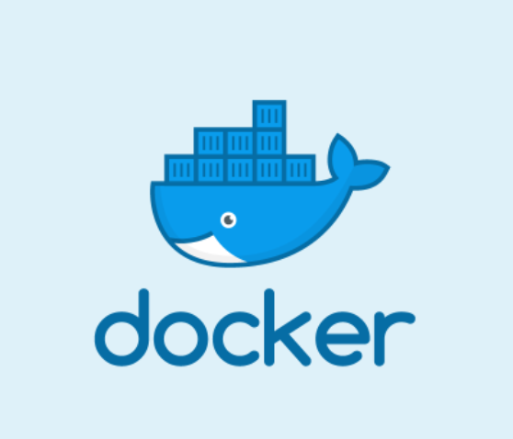
Container Tools
Docker

Slide 4
Topics
Installation
Docker Architecture
Docker Container
Docker Image
Dockerfile
Docker Volume
Docker Network
Docker Compose

Slide 5
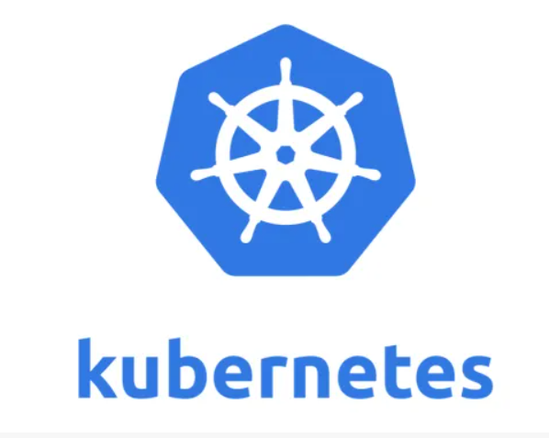
Container Orchestration Tools
Kubernetes

Slide 6
Topics
Installation
Kubernetes Architecture
Pods
Services
ReplicaSet
Deployment

Slide 7
Topics
StatefullSet
Namespace
Scheduling
Ingress
Storage
Troubleshooting

Slide 8
Topics
ConfigMap
Secret
Types of Containers
DaemonSet

Slide 9
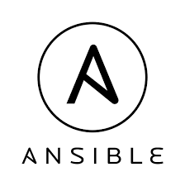
Configuration Management Tools
Ansible

Slide 10
Topics
Introduction
Architecture
Installation
Ad-hoc commands
Ansible Facts
Static and Dynamic Inventories

Slide 11
Topics
Ansible Variables
Playbooks
Handlers
Tags
Loop
Error Handling

Slide 12
Topics
Ansible Vault
Ansible Role
Ansible for AWS

Slide 13

CICD Tools
Jenkins

Slide 14
Topics
Introduction
Installation
Jenkins UI overview
Jobs
Pipelines
CICD

Slide 15
Topics
Jenkins Nodes
Plugins
Maven
CICD Project

Slide 16


Version Control System
Git & GitHub

Slide 17
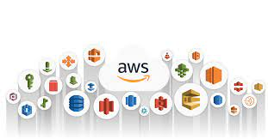
Cloud Providers
AWS

Slide 18
Topics
Introduction
AWS Availability Zone and Region
IAM
Elastic Cloud Compute - EC2
EBS / EFS
Load Balancer

Slide 19
Topics
AutoScaling Group
Simple Storage Service - S3
Route53
Simple Queue Service - SQS
Simple Notification Service – SNS
Database

Slide 20
Infrastructure as code
Terraform
Cloudformation

Slide 21
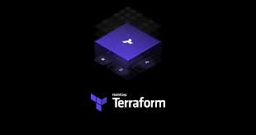
Infrastructure as code
Terraform

Slide 22
Tools

